Slide 1
Framework for
Effective Board Governance of Health System Quality
Patricia McGaffigan, RN, MS, CPPS
Vice President, Safety Programs
President, Certification Board for Professionals in Patient Safety
@PMcGaffigan_IHI
April 3, 2019

Slide 2
Disclosures
IHI/NPSF gratefully acknowledges the support of Medtronic, Inaugural Funder of the Lucian Leape Institute.
Medtronic had no involvement in the development, content, or production of this work

Slide 3

Overview
Describe the aim of the Framework for Effective Board Governance of Health System
Identify the Framework’s key areas of quality oversight
Evaluate the potential use of this framework with your leaders and trustees
@PMcGaffigan_IHI

Slide 4
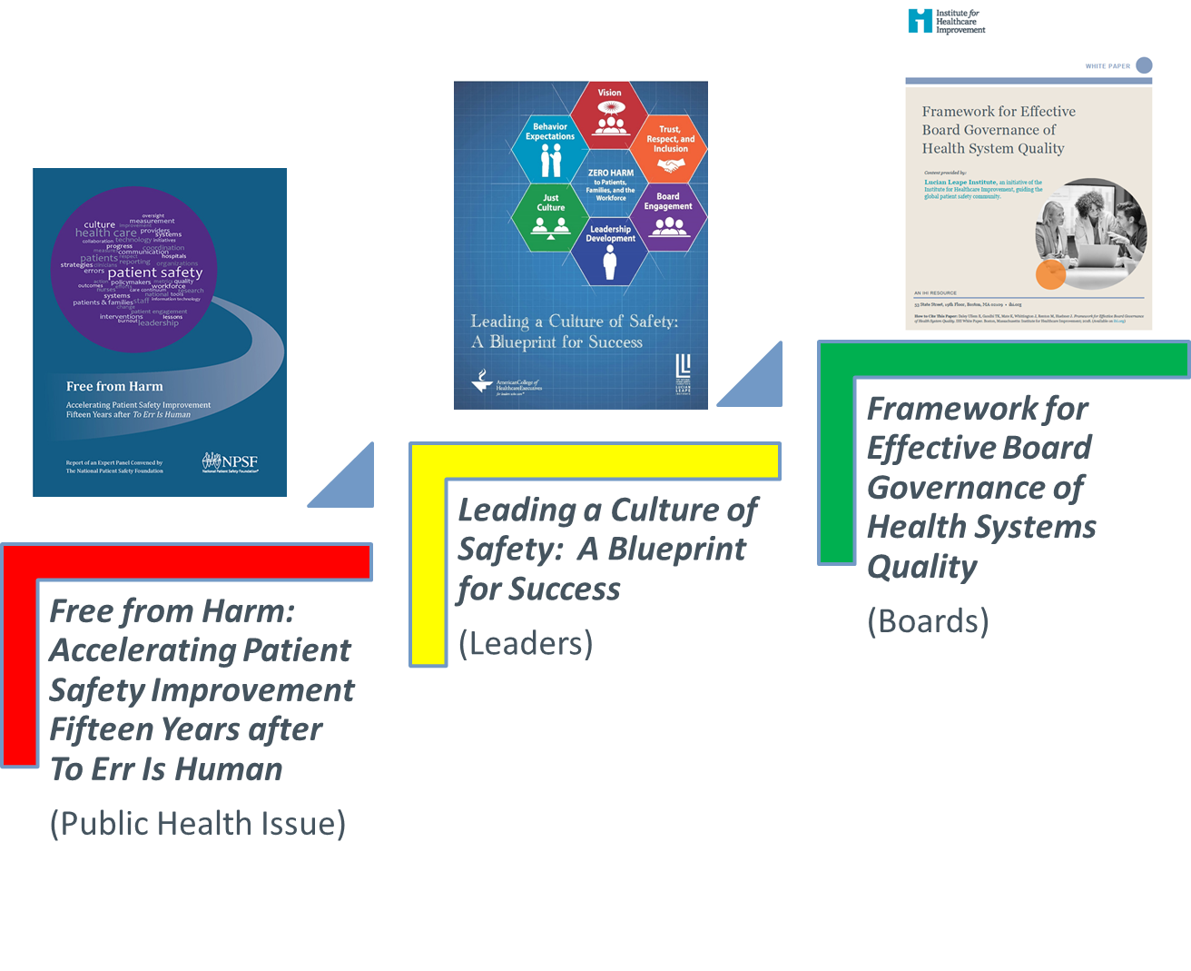
2015
2017
2018

Slide 5

Leading a Culture of Safety: A Blueprint for Success
Strategic guidance and practical tools to lead the implementation of cultures focused on patient and workforce safety
6 domains: recommendations for Foundational and Sustaining levels

Slide 6
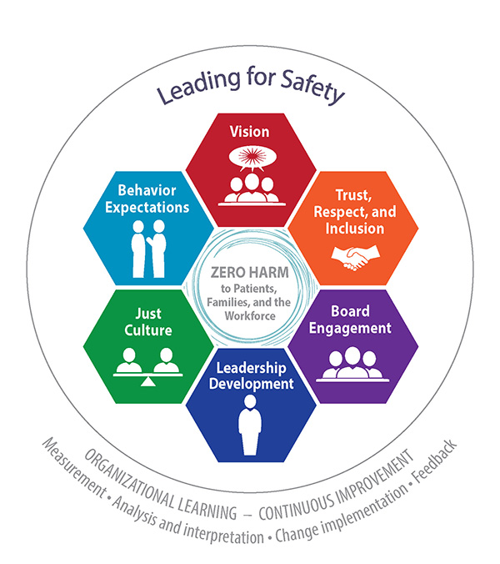
The Six Domains
Establish organizational behavior expectations
Establish a compelling vision for safety
Value trust, respect, and inclusion
Lead and reward a just culture
Prioritize safety in the selection and development of leaders
Select, develop, and engage your Board

Slide 7
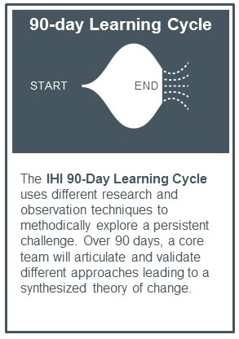
Governance Project Approach
Three 90-day learning cycles
Over 100 interviews with governance educators, experts, trustees, and senior leaders
Country-wide inventory of existing programs and initiatives in governance quality education and training
Expert panel

Slide 8
Current State and Need
What we heard:
  Primarily focused on safety and is hospital-centric, with limited focus on population or community health
  Variable across organizations and states (focus, time, access, coverage of STEEP dimensions of quality, & connectedness to the work of the board)
  Variable processes
What was requested
  Clear, consistent framework for governance of health system quality
  A call to action to raise expectations and improve support for board governance of health system quality
Daley Ullem E, Gandhi TK, Mate K, Whittington J, Renton M, Huebner J. Framework for Effective Board Governance of Health System Quality. IHI White Paper. Boston, Massachusetts: Institute for Healthcare Improvement; 2018. (Available on ihi.org)

Slide 9

Framework for Effective Board Governance of Health System Quality
Daley Ullem E, Gandhi TK, Mate K, Whittington J, Renton M, Huebner J. Framework for Effective Board Governance of Health System Quality. IHI White Paper. Boston, Massachusetts: Institute for Healthcare Improvement; 2018. www.ihi.org/BoardQuality

Slide 10
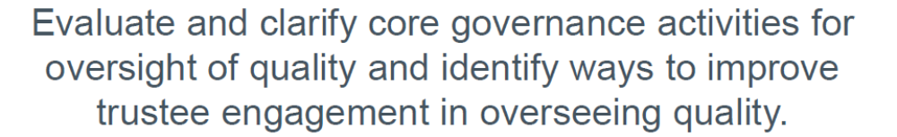

High-Level Aim

Slide 11

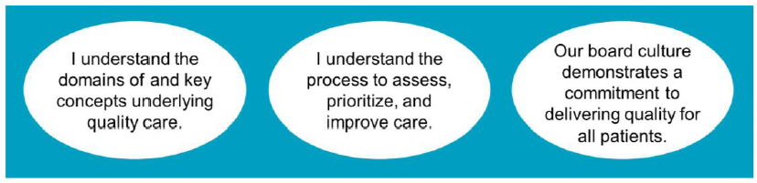
Vision
Notes:
Objectives
Raise the bar
Reduce variation in and clarify trustee responsibilities for quality oversight
Provide practical tools for trustees and the leaders who support them to govern quality in a way that will deliver better care to patients and communities

Slide 12
Governance Resource Includes
A clear, actionable framework for oversight of all the dimensions of quality
Governance of Quality Assessment tool (GQA) for trustees and health system leaders to evaluate and score current quality oversight processes and assess progress in improving board quality oversight over time
Three central knowledge area support guides for governance of quality

Slide 13
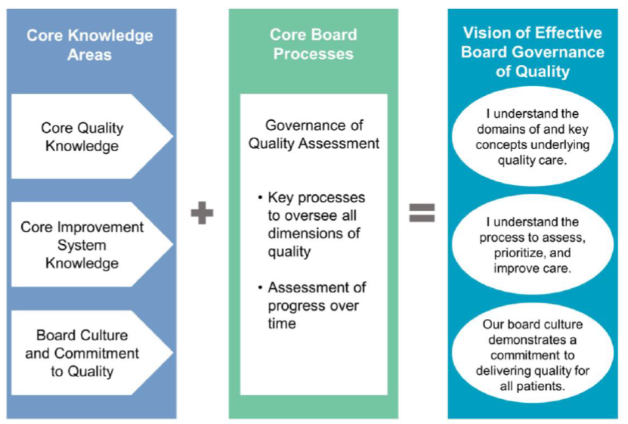
Framework for Governance of Health System Quality
Daley Ullem E, Gandhi TK, Mate K, Whittington J, Renton M, Huebner J. Framework for Effective Board Governance of Health System Quality. IHI White Paper. Boston, Massachusetts: Institute for Healthcare Improvement; 2018. (Available on ihi.org)

Slide 14
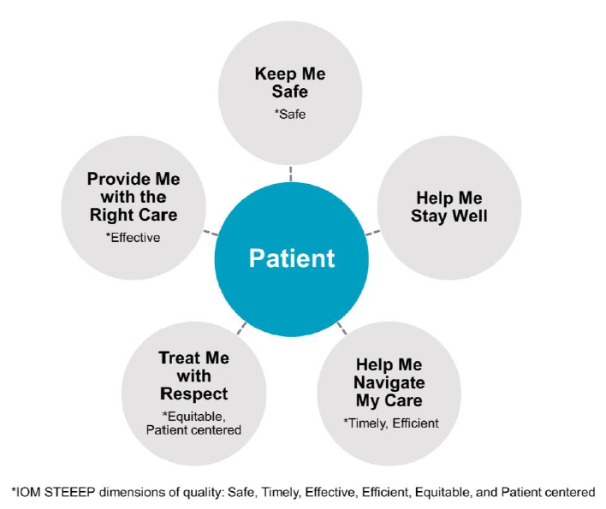
Core Components of Quality
The Patient’s Perspective
Daley Ullem E, Gandhi TK, Mate K, Whittington J, Renton M, Huebner J. Framework for Effective Board Governance of Health System Quality. IHI White Paper. Boston, Massachusetts: Institute for Healthcare Improvement; 2018. (Available on ihi.org)

Slide 15
Governance of Quality Assessment
Snapshot of 30 core processes organized into six categories:
Category 1 | Prioritize Quality: Board Quality Culture and Commitment
Category 2 | Keep Me Safe: Safe Care
Category 3 | Provide Me with the Right Care: Effective Care
Category 4 | Treat Me with Respect: Equitable and Patient-Centered Care
Category 5 | Help Me Navigate My Care: Timely and Efficient Care
Category 6 | Help Me Stay Well: Community and Population Health and Wellness

Slide 16
Governance of Quality Assessment
Purpose:
Assess current state and track results over time of health systems
Guide discussions with senior leaders and trustees
Guide design of educational sessions presented by governance educators
The Governance of Quality Assessment (GQA) serves as:
A roadmap of the key processes the board should undertake to oversee quality
An assessment of how well the board is doing with respect to those processes
https://gqaonlinetool.questionpro.com

Slide 17
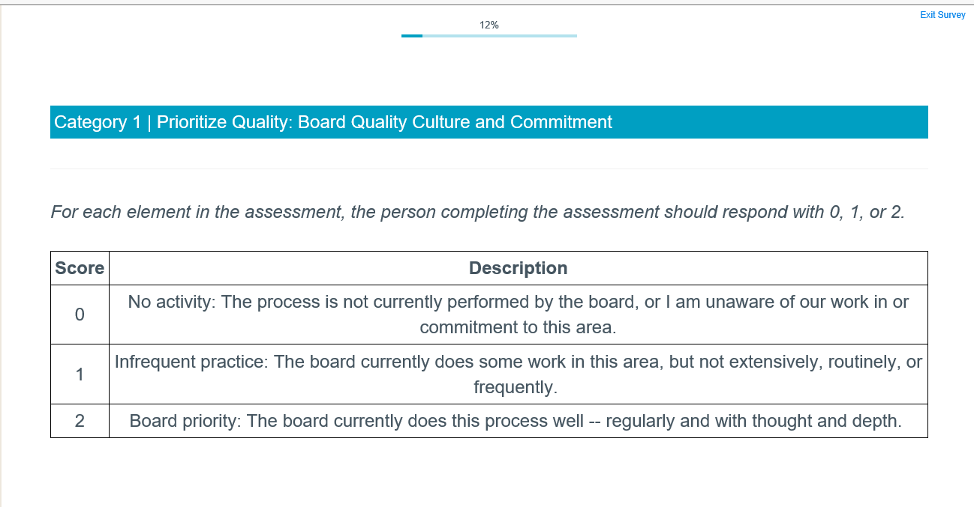

Slide 18
Survey Data

Slide 19
Governance Support Guides
1. Core Quality Knowledge
  Outlines the quality concepts in which trustees should be versed
  Includes key questions for trustees to answer and concepts to be taught
2. Core Improvement System Knowledge
  Outlines what trustees should know about how their health system approaches improvement
3. Board Culture and Commitment
  Outlines attributes of a board culture that support quality care and continuous improvement.

Slide 20
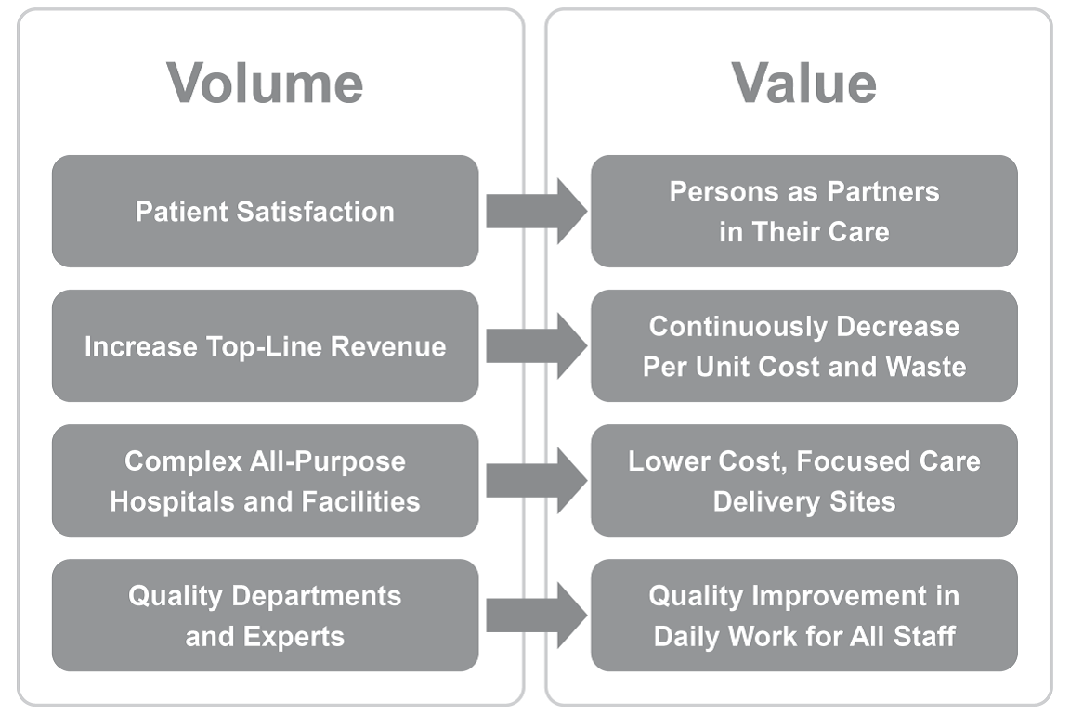
On the Workforce and Value

Slide 21
Taking Action
Download the whitepaper (www.ihi.org/BoardQuality)
Complete the online self-assessment & review resuts (https://gqaonlinetool.questionpro.com)
Share the link with your network
Use this content in your upcoming and future work with leaders, boards, and in other programs

Slide 22
Thank you, and for more
Ihi.org
pmcgaffigan@ihi.org
@PMcGaffigan_IHI

